Slide 1
Key Success Factors of Digital Transformation
Vision and Mission
Strategy
KRAs and KPIs
Process Workflow
Business Process Cycle
Instinctual Connect
Measurement
Change Management
Digital Technology
ICT
Moore’s Law
Internet
Data Communication
SMAC
IoT
Software
Tools
Digital Strategy and Process
Digital Mindset & Skills
Disruptive Innovation
Non-disruptive Innvn
Common techniques
Cross-Pollination
Intersection & Fusion
Dare-To-Try
Innovation in DX
Backbone & Empwrmt
Risk-takers
Data-Driven
Customer Obsessed
Tech-savvy
Business-savvy
Agile
Empowered
Adaptable
DIGITAL TRANS-FORMATION
Innovation –Business Models &
Technology
Business Technology Alignment
Cust Interaction stages
Customer Touchpoints
Data Collection
Fm Data to Insights
Fm Insights to Strategy
Customer Life Cycle
Customer centricity
Voice of Customer
Outcome driven
Shared Culture
Strategy alignment
Structure alignment
Process alignment
Drive for Innovation
Aligned Priorities
Tactical alignment
Customer Experience Management
Drive for DATA is embedded in each KSF
© Ashish Pachory

Slide 2
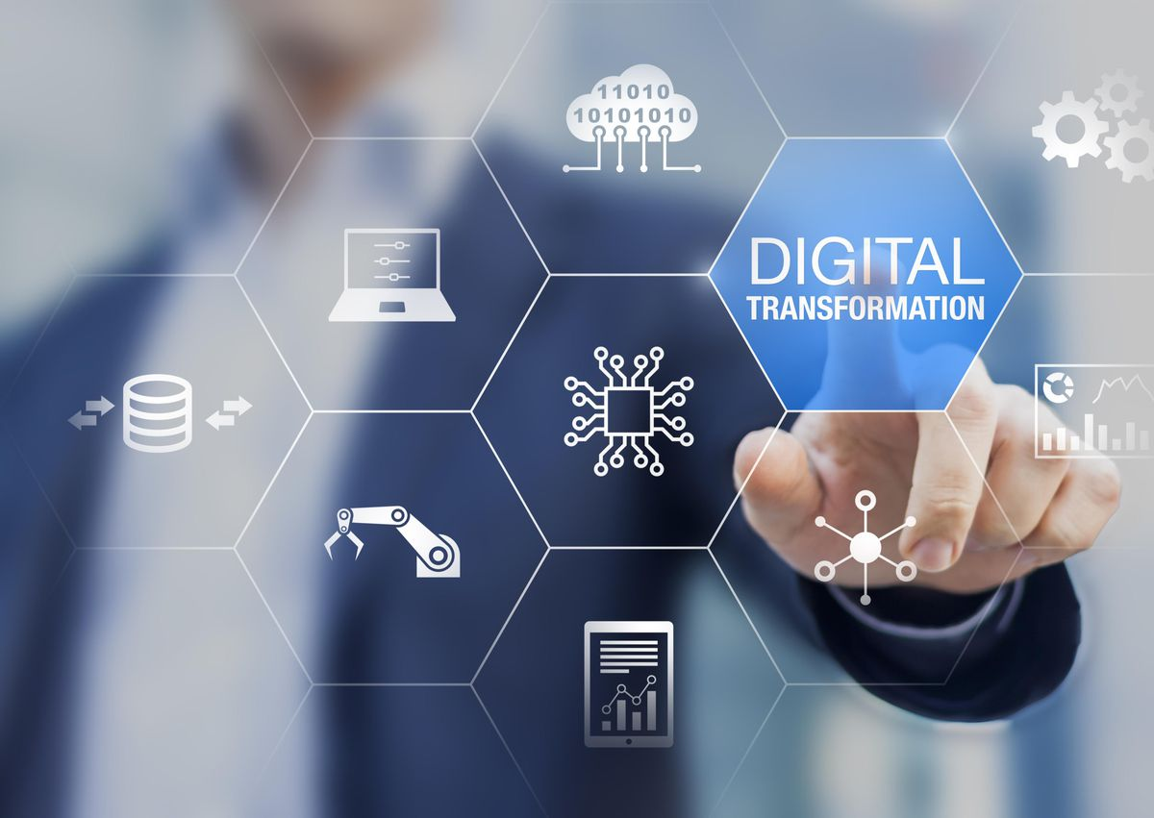
Lecture Series
Strategy & Process Transformation
apachory@iitgoa.ac.in
Ashish Pachory

Slide 3

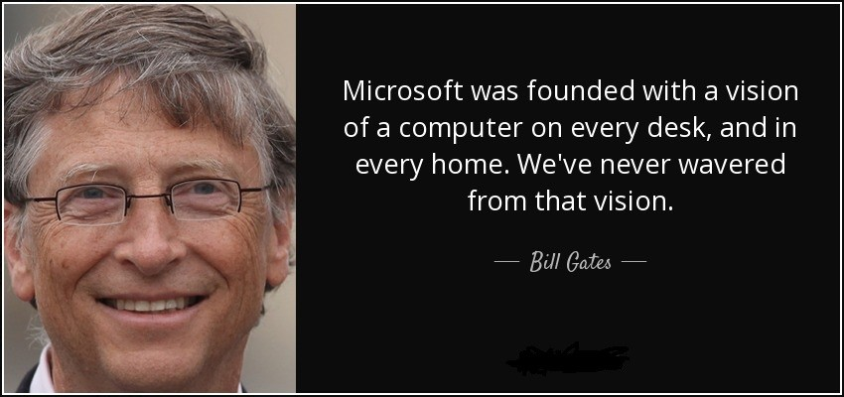
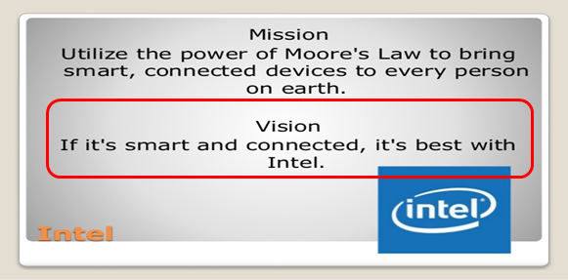
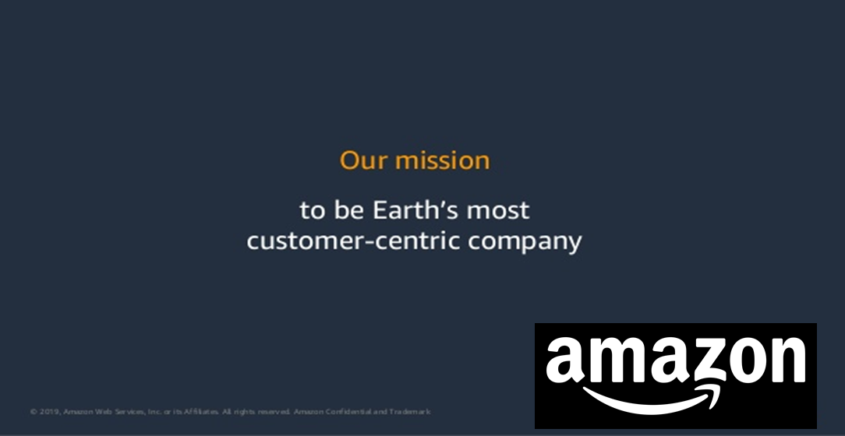
Vision
The VISION defines the optimal desired future state – the mental picture of what an organization wants to achieve over time
Business
Technology

Slide 4
Mission, Vision and Strategy
Mission
Why do we exist?
At Company Level
People
Process
Technology
Purpose & Direction
Vision
At Company Level
Who do we intend to be?
Strategic Goals
What must we achieve?
Specific to Function
Objectives
Execution Plan
What are the measurable outcomes?
Specific to Function
What are the planned actions and results?
KRAs, Action Plans
For each Individual
KPIs (Measurement)
Outcome
What is the measure of success?
At Company Level
© Ashish Pachory

Slide 5
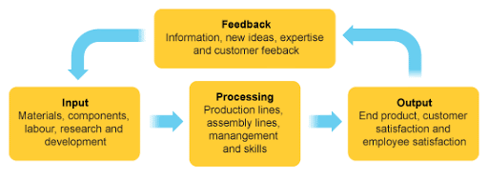
What’s a Process?
DIGITAL ENTERPRISE PROCESSES
Functional Process
Productivity
Efficiency
Discipline
Organizational Process
Input (aspirations)
Conformance
Output (value)
Revenue
Business Process
Customer Service
A business process is a collection of related, structured activities or tasks by people or equipment in which a specific sequence produces a service or product for a particular customer or customers.
Instinctual Connect
Solutions
Alignment
Feedback
© Ashish Pachory

Slide 6
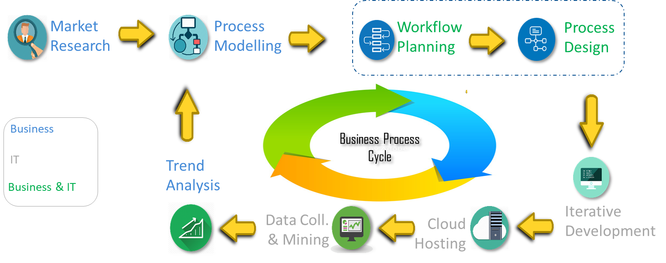
Digital Business Process Cycle
Process Modelling: Visual representation of planned processes and their relationships with other processes
Workflow Planning: Defining and creating a sequence of events as an ordered workflow
Process Design: Representation of specific process modules and specifications to support development
© Ashish Pachory

Slide 7
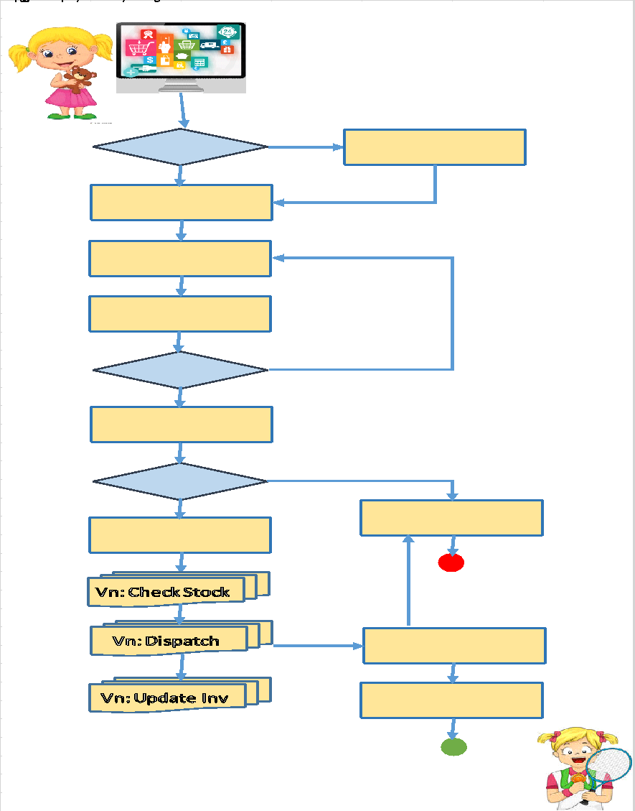
Digital Process Work-flow (Example)
Business Process | Convenience | Intuitiveness | Flexibility | Simplicity | Portability | Performance
---
---
---
Convenience: As a user, would you consider that this process contributes to making things convenient for you?
Intuitiveness: Does the process anticipate needs and help to make more informed decisions?
Flexibility: Is it easy to make changes or personalize the process to suit specific market requirements?
Simplicity: Would your grandparents be comfortable using the process without assistance?
Portability: How accommodative is the process in adapting to different environments (devices, cloud, OS, future trends)?
Performance: How well does the process work under varying load and traffic conditions?
© Ashish Pachory

Slide 8
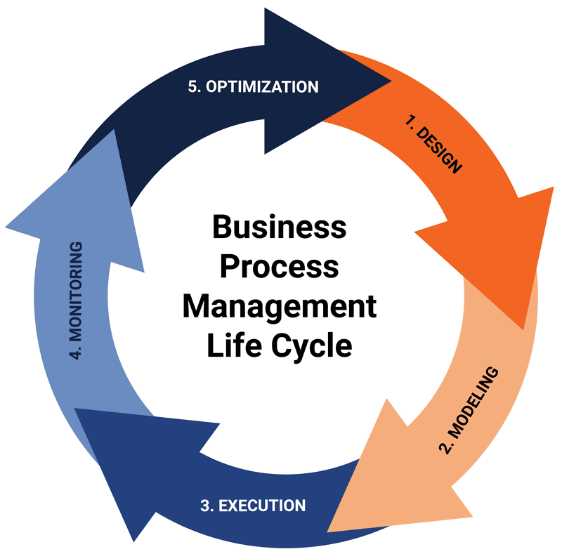
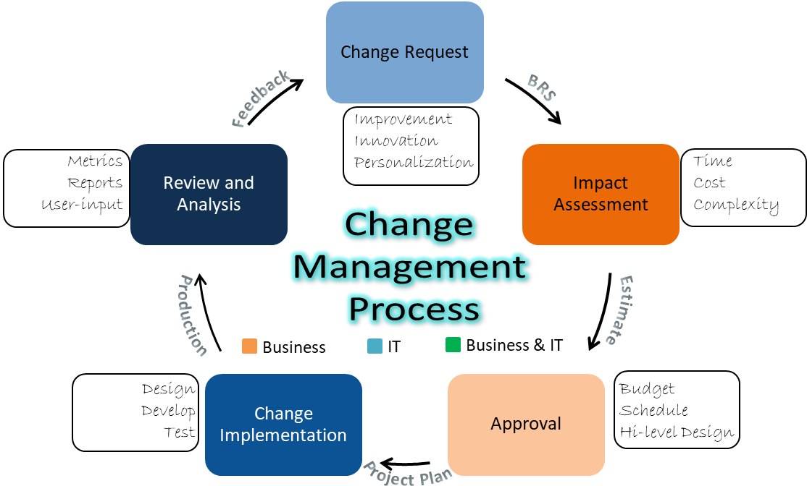
Change Management Process
BUSINESS PROCESS MANAGEMENT (BPM) CYCLE
CHANGE MANAGEMENT CYCLE)
© Ashish Pachory

Slide 9
Assignment
1. Create a process flowchart for registering yourself, selecting, and enrolling for an elective course at IIT Goa.
2. Pick any 5 Digital business processes that you use routinely. Rate each of these on a scale of 1 (worst) to 5 (best) under each process attribute on slide 7.
3.

